Slide 1
The Emergence and future of data science
Jeff Goldsmith, PhD
Columbia Biostatistics

Slide 2
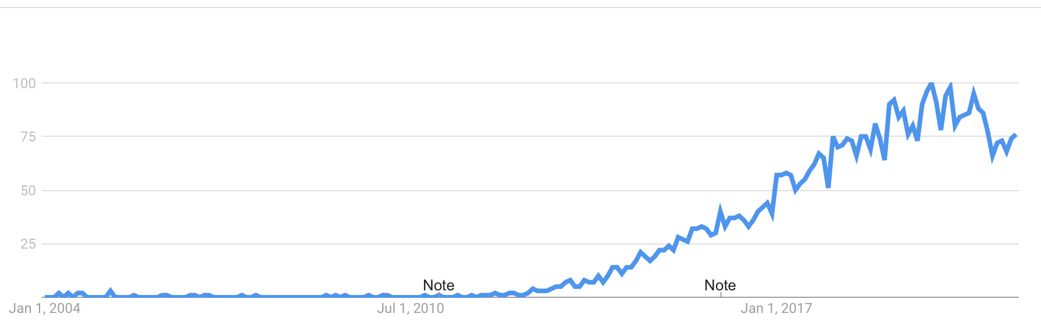
Data science is pretty new

Slide 3
Coauthors
The Emergence and Future of Public Health Data Science
Jeff Goldsmith, Yifei Sun, Linda P. Fried, Jeannette Wing, Gary W. Miller, Kiros Berhane

Slide 4
My background in data science
I do functional data analysis motivated by
Wearable devices (accelerometers, mostly)
Motor control (stroke recovery; brain / behavior dynamics)
I’ve taught P8105: Data Science I since 2017
Intended for MS students in biostatistics
Enrollment is now approx. 200
(That’s more than 20, but less than a million)
Think “tidyverse as a service course”

Slide 5
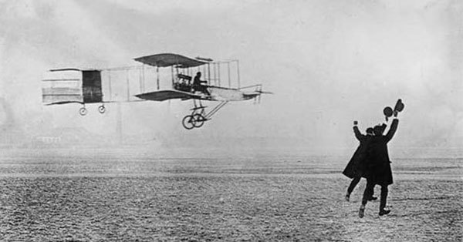
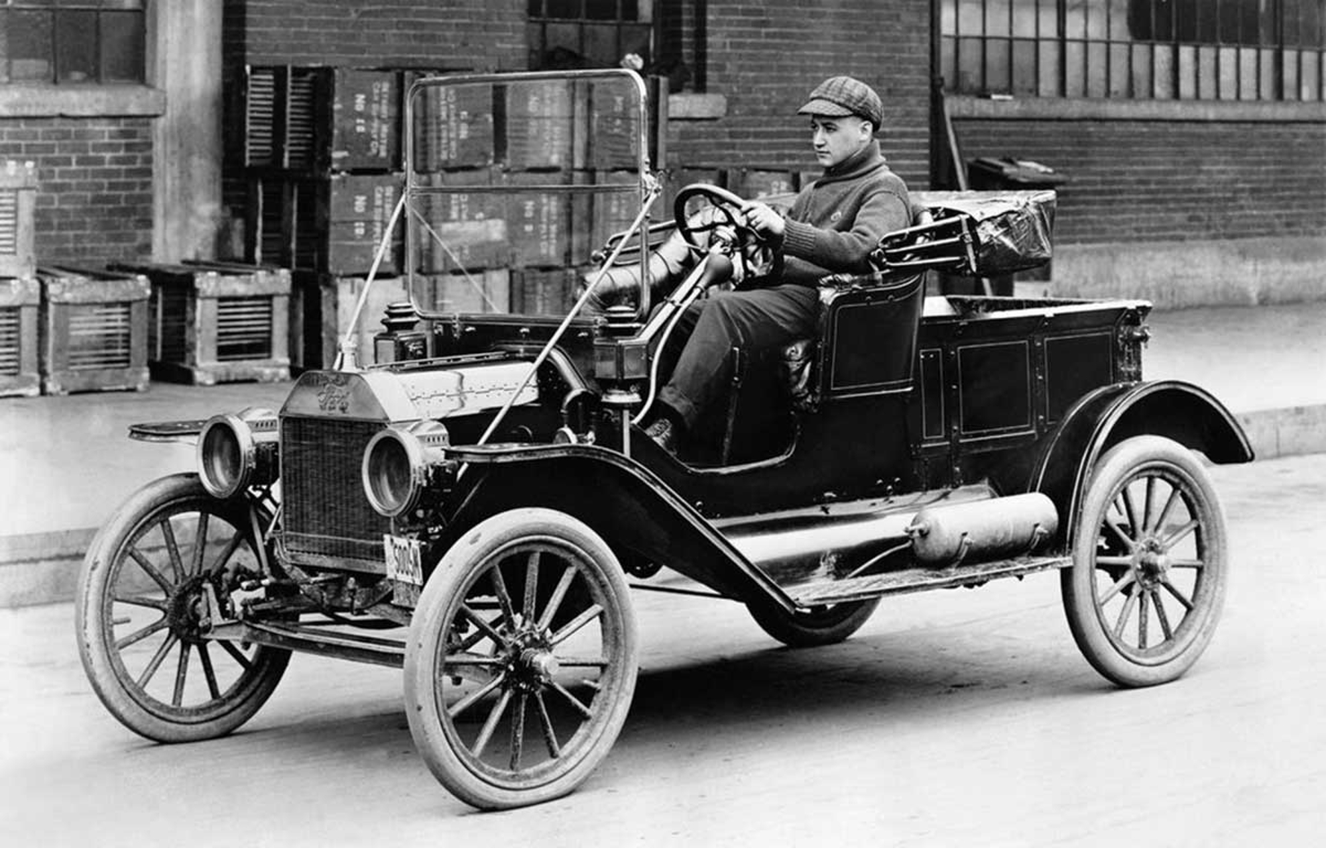
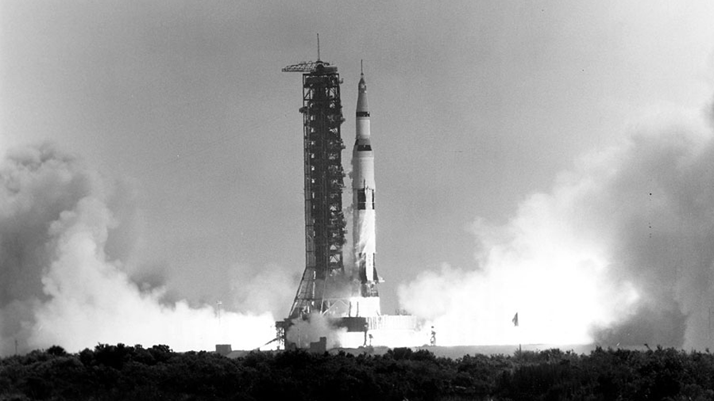
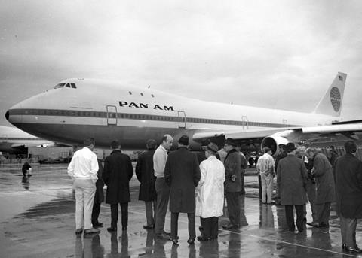
A data science analogy
1910s
1969 / 1970

Slide 6
Defining data science
Data science is the study of extracting value from data.

Slide 7
Another definition
Data science is the study of formulating and rigorously answering questions using a data-centric process that emphasizes clarity, reproducibility, effective communication, and ethical practices.

Slide 8
ISI 2017

Slide 9
First question from the audience
“What is the point of ‘data science’? Aren’t we already data scientists?”
🤣👏🎉🤣👏😀🎊👍🎉👍🤣😁🎉😀👏👏😁🎊👏👍😀🎉😀👏🎉🎊😁🎉😁🤣🎊🤣🤣👏🎉🤣👏😀🎊👍🎉👍🤣😁🎉😀👏👏😁🎊👏👍😀🎉😀👏🎉🎊😁🎉😁🤣🎊🤣🤣👏🎉🤣👏😀🎊👍🎉👍🤣😁🎉😀👏👏😁🎊👏👍😀🎉😀👏🎉🎊😁🎉😁🤣🎊🤣🤣👏🎉🤣👏😀🎊👍🎉👍🤣😁🎉😀👏👏😁🎊👏👍😀🎉😀👏🎉🎊😁🎉😁🤣🎊🤣🤣👏🎉🤣👏😀🎊👍🎉👍🤣😁🎉😀👏👏😁🎊👏👍😀🎉😀👏🎉🎊😁🎉😁🤣🎊🤣🤣👏🎉🤣👏😀🎊👍🎉👍🤣😁🎉😀👏👏😁🎊👏👍😀🎉😀👏🎉🎊😁🎉😁🤣🎊🤣🤣👏🎉🤣👏😀🎊👍🎉👍🤣😁🎉😀👏👏😁🎊👏👍😀🎉😀👏🎉🎊😁🎉😁🤣🎊🤣🤣👏🎉🤣👏😀🎊👍🎉👍🤣😁🎉😀👏👏😁🎊👏👍😀🎉😀👏🎉🎊😁🎉
🤦‍♂️🙁😡👎🙄🙁🤦‍♂️😑🙄👎😡🙁🤦‍♂️🙁👎😡🤦‍♂️🙄😑🤬👎🙄😑🤦‍♂️🥱🤦‍♂️😑😡🙄🤦‍♂️🙁😡👎🙄🙁🤦‍♂️😑🙄👎😡🙁🤦‍♂️🙁👎😡🤦‍♂️🙄😑🤬👎🙄😑🤦‍♂️🥱😑🙄🤦‍♂️🙁😡👎🙄🙁🤦‍♂️😑🙄👎😡🙁🤦‍♂️🙁👎😡🤦‍♂️🤦‍♂️🙁😡👎🙄🙁🤦‍♂️😑🙄👎😡🙁🤦‍♂️🙁👎😡🤦‍♂️🙄😑🤬👎🙄😑🙄😑🤬👎🙄😑🤦‍♂️🥱🤦‍♂️😑😡🙄🤦‍♂️🙁😡👎🙄🙁🤦‍♂️😑🙄👎😡🙁🤦‍♂️🙁👎😡🤦‍♂️🙄😑🤬👎🙄😑😑🤦‍♂️🥱🤦‍♂️😑😡🙄🤦‍♂️🙁😡👎🙄🙁🤦‍♂️😑🙄👎😡🙁🤦‍♂️🙁👎😡🤦‍♂️🙄😑🤬👎🙄😑🤦‍♂️🥱🤦‍♂️😑😡😑🤦‍♂️🥱🙁🤦‍♂️😑🙄👎😡🙁🤦‍♂️🙁👎😡🤦‍♂️🙄😑🤬👎🙄😑🤦‍♂️🥱🤦‍♂️😑😡🙄😑🤬👎🙄😑🤦‍♂️🥱🤦‍♂️😑😡🙄🤦‍♂️🙁😡👎🙄🙁🤦‍♂️😑🙄👎😡🙁🤦‍♂️🙁👎😡🤦‍♂️🙄😑🤬👎🙄😑😑🤦‍♂️🥱🤦‍♂️😑😡😡👎🙄🙁🤦‍♂️😑🙄👎😡🙁🤦‍♂️🙁👎😡🤦‍♂️🙄😑🤬👎🙄😑🙄🙄

Slide 10
Response from Hadley Wickham (roughly)
“A data scientist is a statistician who’s useful”
🤦‍♂️🙁😡👎🙄🙁🤦‍♂️😑🙄👎😡🙁🤦‍♂️🙁👎😡🤦‍♂️🙄😑🤬👎🙄😑🤦‍♂️🥱🤦‍♂️😑😡🙄🤦‍♂️🙁😡👎🙄🙁🤦‍♂️😑🙄👎😡🙁🤦‍♂️🙁👎😡🤦‍♂️🙄😑🤬👎🙄😑🤦‍♂️🥱😑🙄🤦‍♂️🙁😡👎🙄🙁🤦‍♂️😑🙄👎😡🙁🤦‍♂️🙁👎😡🤦‍♂️🤦‍♂️🙁😡👎🙄🙁🤦‍♂️😑🙄👎😡🙁🤦‍♂️🙁👎😡🤦‍♂️🙄😑🤬👎🙄😑🙄😑🤬👎🙄😑🤦‍♂️🥱🤦‍♂️😑😡🙄🤦‍♂️🙁😡👎🙄🙁🤦‍♂️😑🙄👎😡🙁🤦‍♂️🙁👎😡🤦‍♂️🙄😑🤬👎🙄😑😑🤦‍♂️🥱🤦‍♂️😑😡🙄🤦‍♂️🙁😡👎🙄🙁🤦‍♂️😑🙄👎😡🙁🤦‍♂️🙁👎😡🤦‍♂️🙄😑🤬👎🙄😑🤦‍♂️🥱🤦‍♂️😑😡😑🤦‍♂️🥱🙁🤦‍♂️😑🙄👎😡🙁🤦‍♂️🙁👎😡🤦‍♂️🙄😑🤬👎🙄😑🤦‍♂️🥱🤦‍♂️😑😡🙄😑🤬👎🙄😑🤦‍♂️🥱🤦‍♂️😑😡🙄🤦‍♂️🙁😡👎🙄🙁🤦‍♂️😑🙄👎😡🙁🤦‍♂️🙁👎😡🤦‍♂️🙄😑🤬👎🙄😑😑🤦‍♂️🥱🤦‍♂️😑😡😡👎🙄🙁🤦‍♂️😑🙄👎😡🙁🤦‍♂️🙁👎😡🤦‍♂️🙄😑🤬👎🙄😑🙄🙄
🤣👏🎉🤣👏😀🎊👍🎉👍🤣😁🎉😀👏👏😁🎊👏👍😀🎉😀👏🎉🎊😁🎉😁🤣🎊🤣🤣👏🎉🤣👏😀🎊👍🎉👍🤣😁🎉😀👏👏😁🎊👏👍😀🎉😀👏🎉🎊😁🎉😁🤣🎊🤣🤣👏🎉🤣👏😀🎊👍🎉👍🤣😁🎉😀👏👏😁🎊👏👍😀🎉😀👏🎉🎊😁🎉😁🤣🎊🤣🤣👏🎉🤣👏😀🎊👍🎉👍🤣😁🎉😀👏👏😁🎊👏👍😀🎉😀👏🎉🎊😁🎉😁🤣🎊🤣🤣👏🎉🤣👏😀🎊👍🎉👍🤣😁🎉😀👏👏😁🎊👏👍😀🎉😀👏🎉🎊😁🎉😁🤣🎊🤣🤣👏🎉🤣👏😀🎊👍🎉👍🤣😁🎉😀👏👏😁🎊👏👍😀🎉😀👏🎉🎊😁🎉😁🤣🎊🤣🤣👏🎉🤣👏😀🎊👍🎉👍🤣😁🎉😀👏👏😁🎊👏👍😀🎉😀👏🎉🎊😁🎉😁🤣🎊🤣🤣👏🎉🤣👏😀🎊👍🎉👍🤣😁🎉😀👏👏😁🎊👏👍😀🎉😀👏🎉🎊😁🎉

Slide 11
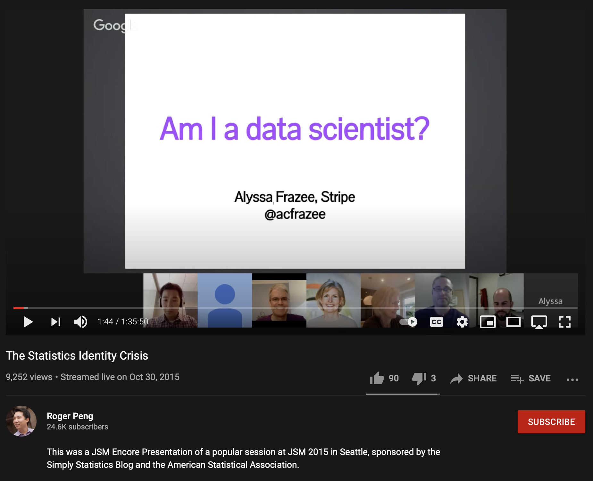
That question is understandable
It’s easy, in 2021, to forget what the statistical identity crisis phase was like
But that was a whole thing, for quite a while

Slide 12
What made “data science” happen
Data science emerged in parallel to six broad trends:
Big data
Emphasis on prediction
Reproducibility crisis in science
Interdisciplinary research
Diversity, equity, and inclusion
Everything should be on the internet
These weren’t new in 2012 and aren’t unique to data science
… but they had a big impact on the “data science” perspective

Slide 13
Connotation >> definition
Core data science values aren’t built into the definition, but were critical to the valence of “data science”
In statistics, “data science” mapped onto existing arguments about what matters to the field
Connotation seemed to resonate with a lot of vaguely disaffected applied statisticians

Slide 14
Data science as external validation
The fact that data science caught on implied that
stated values ≠ demonstrated values
Ideally, this would suggest a need to bring these into closer alignment
Not saying old values were bad – but that other things should be valued, too

Slide 15
Did that happen?
Some, yeah.
More awareness of issues around equity and inclusion
Broader view of important / valid publication outlets
Techniques for working with data are explicitly taught
Slow shift towards expecting better code / reproducibility
(Exciting aside – reproducibility at JASA …)
But also … not in other ways.
“Find ways to get traditional academic products / credit” is the advice given to academic data scientists

Slide 16
So … I think Jeannette is kinda right
Data-oriented disciplines will slowly incorporate the values that “data science” implies in their own ways
That’ll be true enough that “data science” will be a secondary / situational academic identity
“I’m a […] and data scientist” not “I’m a data scientist”
“For this grant, I’m a data scientist”
Upshot is that a maximalist definition of data science will win, in practice, over a definition that tries to create a clear boundary / distinct discipline
This is not a bad thing

Slide 17
Public Health Data Science
[Public health] data science is the study of formulating and rigorously answering questions [in order to advance health and well-being] using a data-centric process that emphasizes clarity, reproducibility, effective communication, and ethical practices.

Slide 18
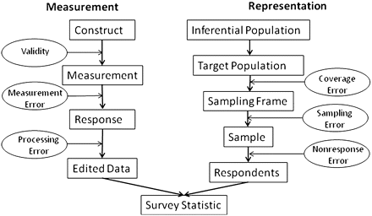
“Public Health” is the important part
Public health training emphasizes some elements that are critical data science thinking and work:
Study design
Sampling process
Measurement process
Desire vs ability to infer causation
Cross-disciplinary collaboration
Engagement with data ethics
Public dissemination and dialog
From “Total Survey Error: Past, Present, and Future” (Groves and Lyberg)
via “Data Alone Isn’t Ground Truth” by Angela Bassa

Slide 19
DS ⟺ PHDS
“Data science” will evolve as it draws on existing domain skills and traditions
PHDS will add some ways of thinking and tools from other quantitative disciplines

Slide 20
Some easy predictions about PHSD
It’ll follow the data science trajectory, just delayed a few years
A “PHDS is just …” phase will happen and then be mostly over
Public health data scientists will be common outside academia
This is why people take my class …
⟹ PHDS training programs will proliferate

Slide 21
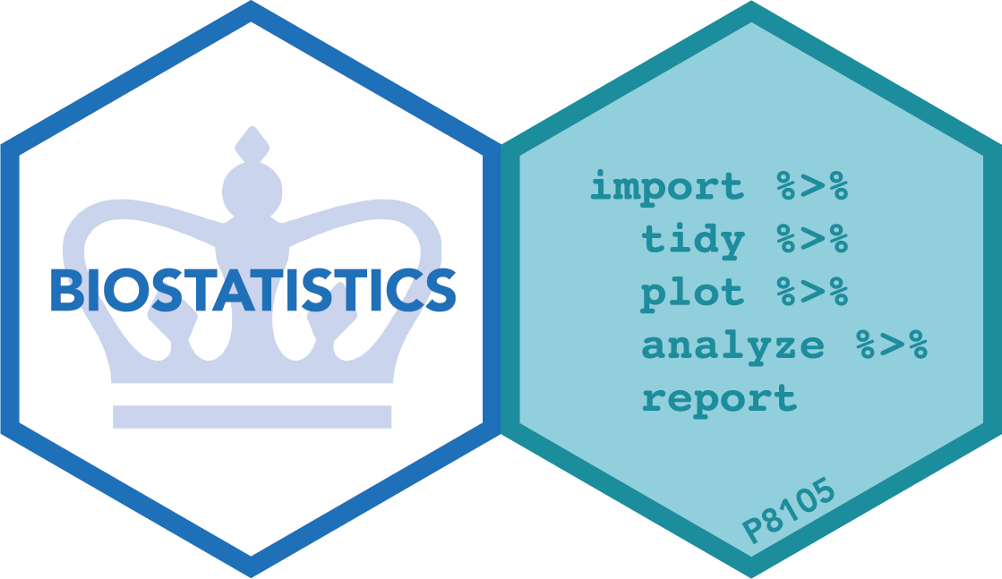
Thanks!
jeff.goldsmith@columbia.edu
jeffgoldsmith.com
github.com/jeff-goldsmith/
P8105.com

